Slide 1
FRA Group 11
Default modeling in R
Logistic, RF and Naïve Bayes

Slide 2
INDEX
Objective
Data Summary
Exploratory Data Analysis
Hypothesis and validation
Model implementation and strategy
Conclusion/Take-away

Slide 3
Objective
We are provided data on loan defaults and our objective is to build default prediction models using R.
Cleaning of data
Handling unbalanced data
Building model(s) on training data
Evaluating model performance using test data

Slide 4
Data Summary
We have used Training.xlsx file for our analysis
This file has got total 6 variables of mixed datatypes
Out of 6 variables, 4 are neumerical variables
Total 5000 records/observation
With Default/Target rate ratio 6:94 –(Yes:No)

Slide 5
Exploratory Data Analysis & Preparation
Data Exploration is a crucial stage of predictive model. We can’t build great and practical models unless we learn and explore the data from begin to end.
This step can be done by visualization and analysis using excel/R
Variable Identification:
This dataset has got 1 Response and 4 predictor/explanatory variables

Slide 6
Exploratory Data Analysis & Preparation
Univariate Analysis: explore variables one by one for Central Tendency, Measure of dispersion etc.
#check for missing values in data set (using R)
table(is.na(Training))
colSums(is.na(Training))
# Normality analysis via Histogram (Visual -refer next slide)
eg. hist(Training$Debtratio, main ="Default",xlab="")

Slide 7
Exploratory Data Analysis & Preparation
#Outlier checking using Boxplot (Visual -refer next slide)
eg. boxplot(Training$Debtratio, main ="Default",xlab="")
Drop unwanted or non-contributing variables from data set (post visual analysis)
#drop unwanted columns (using R) Casenum column 1
Training <- (Training[, -1])
Linear Correlation between Target and predictor

Slide 8
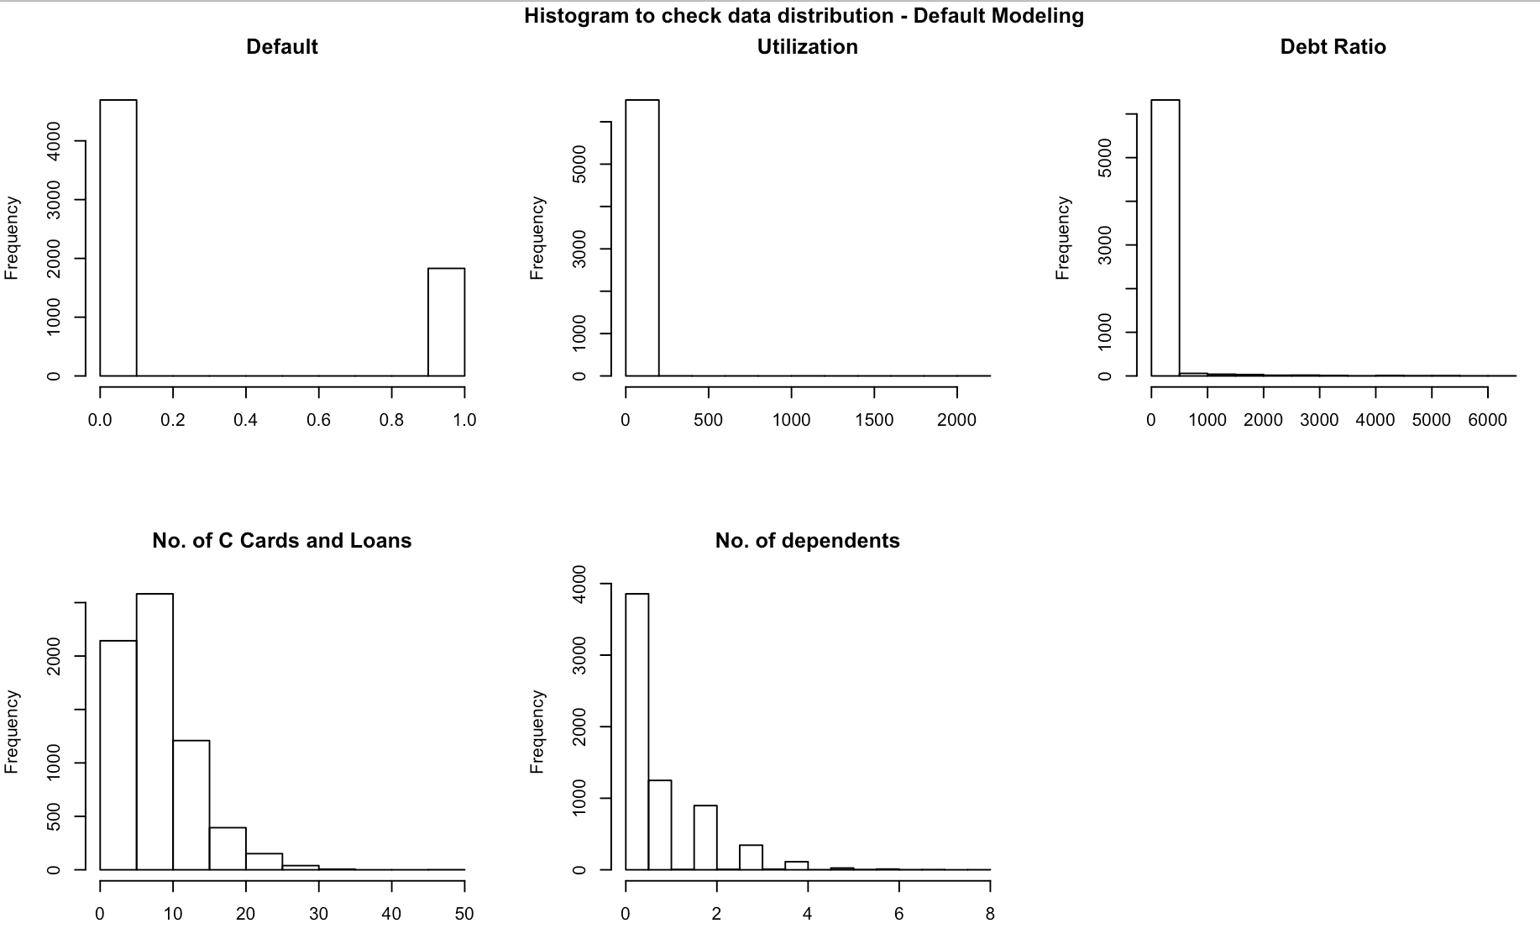
Before Cleaning

Slide 9
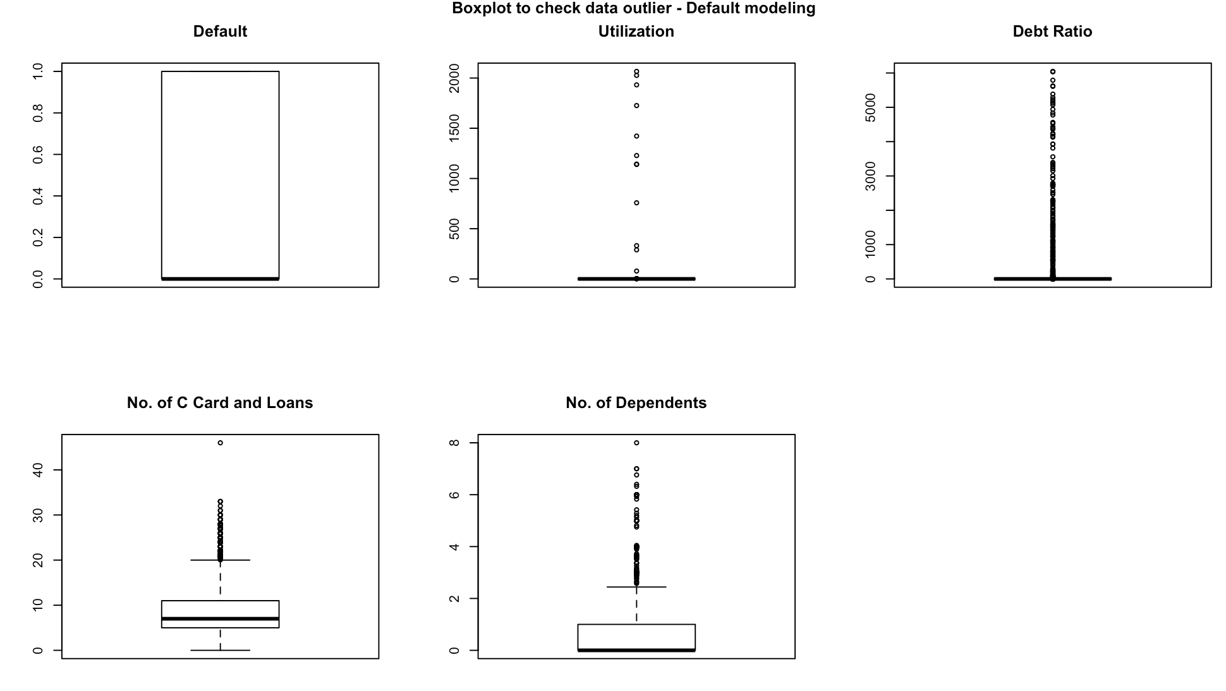
Before Cleaning

Slide 10
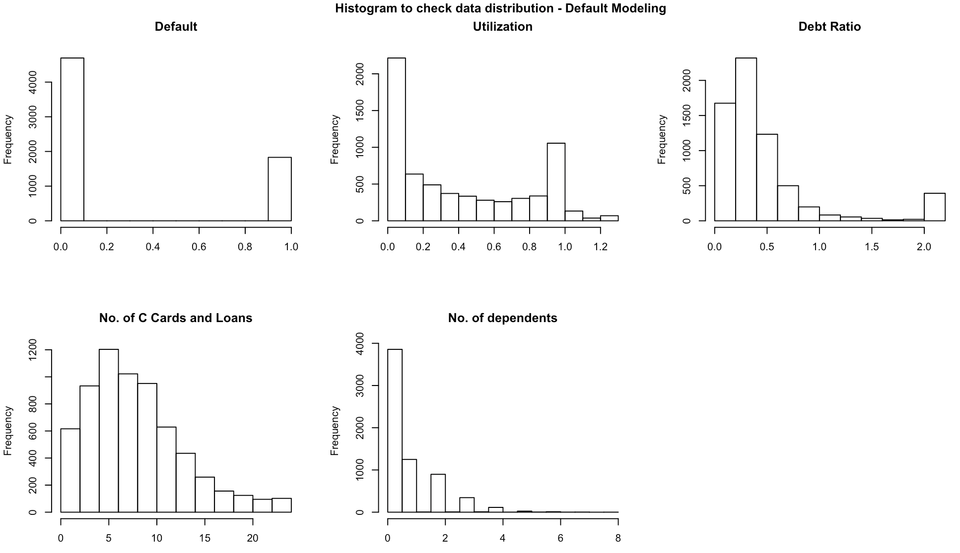
Post Cleaning

Slide 11
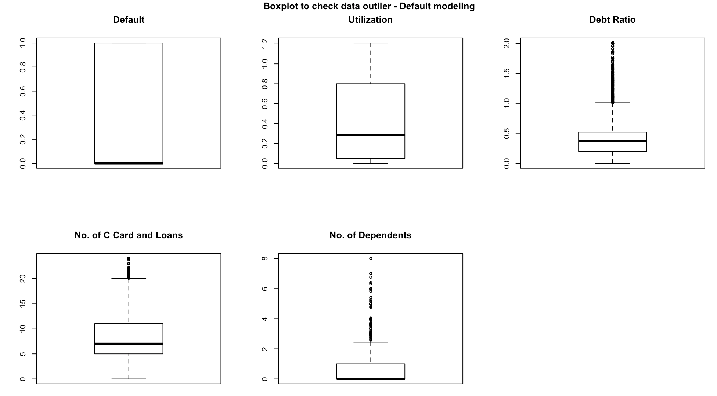
Converted values above 1 to 3rd Quartile i.e. 0.8
Converted values above 10000 to 10000

Slide 12
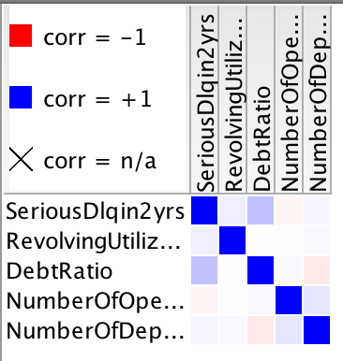

Slide 13
Exploratory Data Analysis & Preparation
Data preparation :
Data is highly imbalanced and needs to be balanced using either–
1) Bootstrapping over-sampling
or
2) SMOTE - Synthetic Minority Over-sampling Technique (<- We will use this)

Slide 14
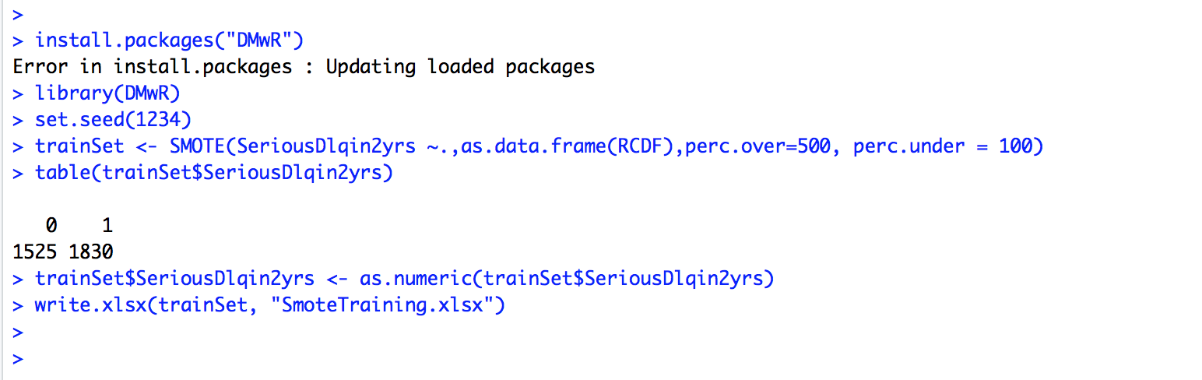
SMOTE
We used Smote generated Default records and appended it to original training dataset to balance it (Default:No-Default):– 28:72(New) from 6:94(old).

Slide 15
Hypothesis
Null Hypothesis(Ho): Predictor variables in Training dataset do not contribute to predict customer default i.e. there is no linear relationship between default and all other predictor variables.
Alternate Hypothesis(H1): There is a linear relationship between customer default and predictor variables i.e. all or some have power to predict default

Slide 16
Hypothesis validation using Linear regression
##Run Linear regression to find significant independent variables from training Data set
ft<- lm(SeriousDlqin2yrs ~ ., data = training)
Summary(ft)
Result: p-value: < 2.2e-16
Assuming alpha value to be 0.01, p-value above is far below alpha and Hence, we can safely reject null hypothesis stating – some or all predictor variables in training dataset contribute to predict employee attrition

Slide 17
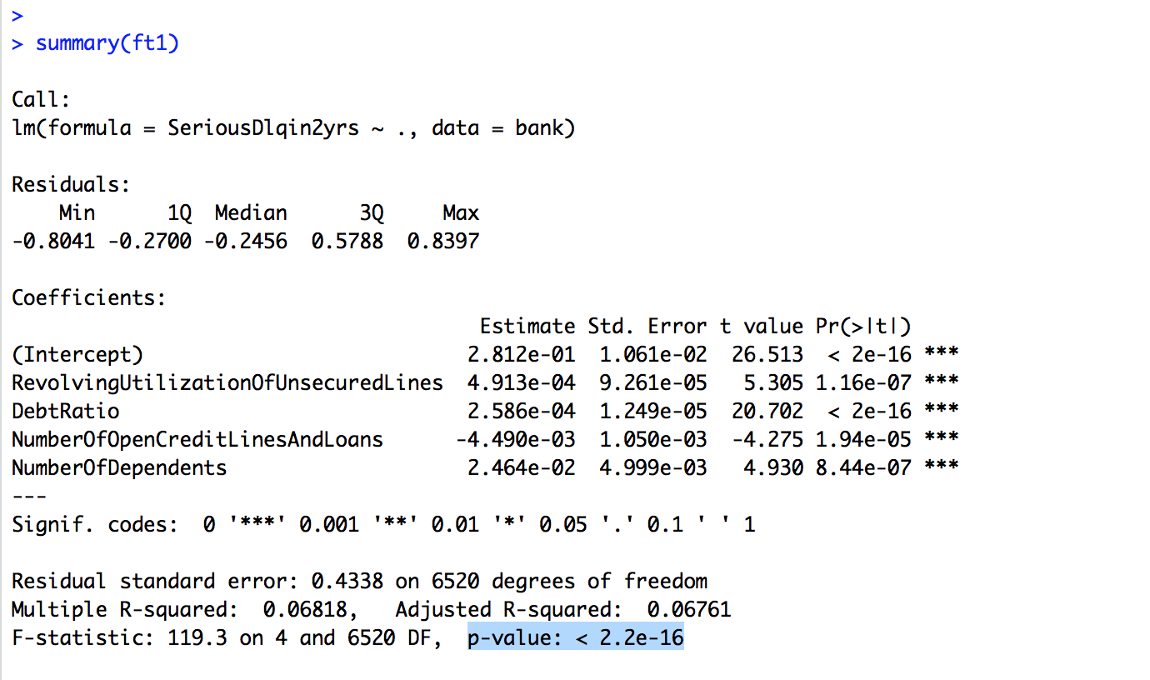
Hypothesis validation using Linear regression
Further , lmtest followed by vif gives below list of significant variables from data set

Slide 18
Let’s build model now
Random forest, Logistic Regression
and
Naïve Bayes Classifier

Slide 19
Random Forest(RF)
How RF can help us infer and then predict default data –
We build Full RF model using scaled RFDF.dev dataset prepared in EDA&P
Plot OOB chart and rebuild pruned RF model based on OOB
Create deciles and then Rank order for development model based on predicted output
Calculate and print Rank table, auc, ks, gini and confusion matrix on dev. sample(refer screenshot on next slide)

Slide 20
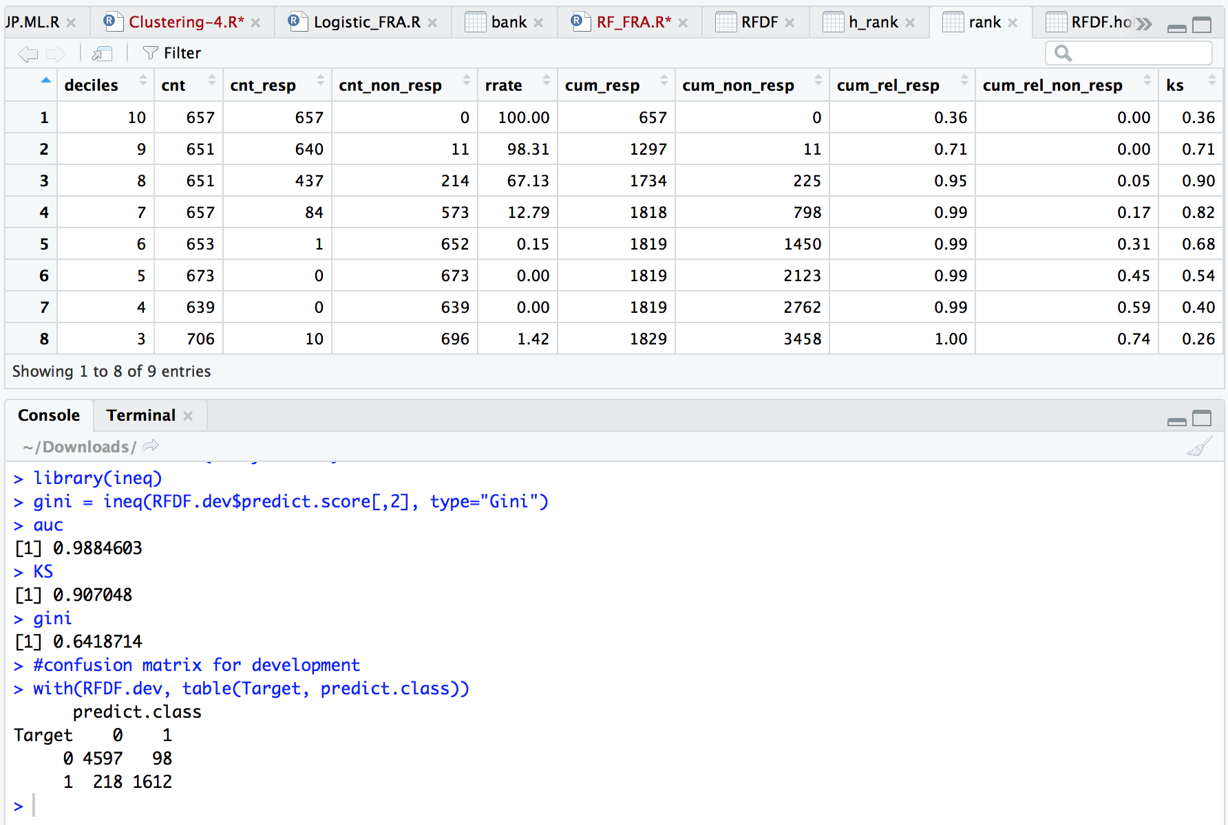
Development Model performance

Slide 21
Analyzing RF development model performance
Looking at performance measure of development Model rf1:
Rank table: Top decile has 100% response rate i.e. 3.6times 28% overall response before applying RF algorithm.
Confusion Matrix: Correctness of prediction is 95% and default prediction rate is 88%.

Slide 22
Run RF model on Holdout data

Slide 23
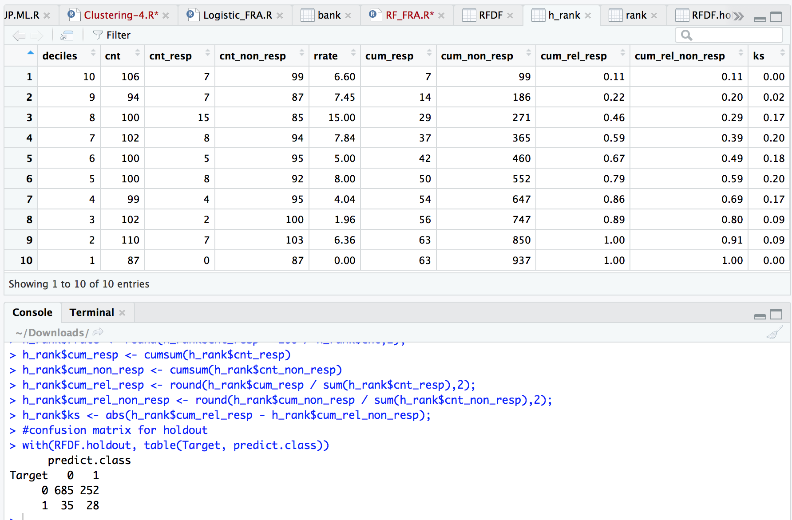
Holdout data Evaluation

Slide 24
Analyzing RF model on unseen holdout data
Looking at performance measure of Model rf1 on unseen data:
Rank table: 3rd decile has 15% response rate i.e. 2.5 times 6% overall response before applying RF algorithm.
Confusion Matrix: Correctness of prediction is 71.3% and default prediction rate is 45%.

Slide 25
Logistic Regression(LR)
How LR can help us infer and then predict purchase –
We build Full LR model using train dataset prepared in EDA&P
Using stepwise function we fine tune model significant variables
Calculate and print auc, ks and confusion matrix on train. sample(refer screenshot on next slide)

Slide 26
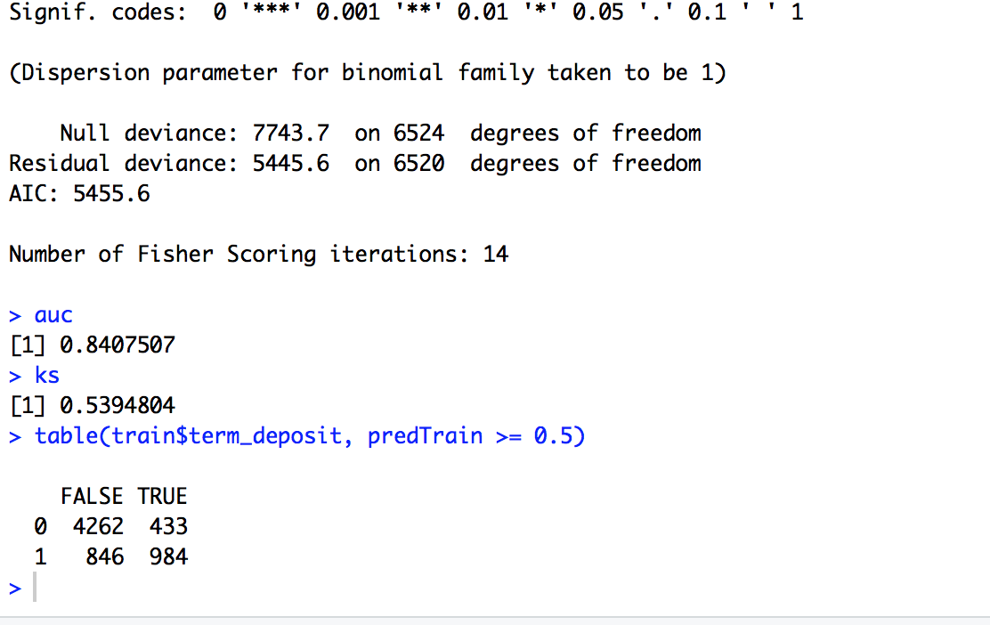
Development Model performance

Slide 27
Analyzing LR train model performance
Looking at performance measure of train model :
Confusion Matrix: Correctness of prediction is 80.39% and default prediction rate is 54%.

Slide 28
Run LR model on test data

Slide 29
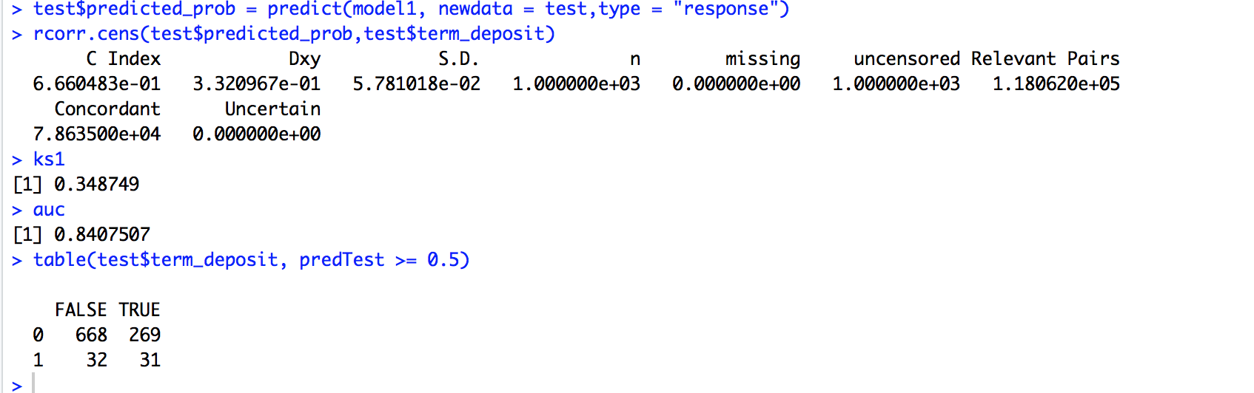
Holdout data Evaluation

Slide 30
Analyzing LR model on unseen test data
Looking at performance measure of model on unseen data:
Confusion Matrix: Correctness of prediction is 70% and default prediction rate is 50%.

Slide 31
Naïve Bayes Classification
How NB can help us infer and then predict purchase –
We build Full LR model using train dataset prepared in EDA&P
Using stepwise function we fine tune model significant variables
Calculate and print auc, ks and confusion matrix on train. sample(refer screenshot on next slide)

Slide 32
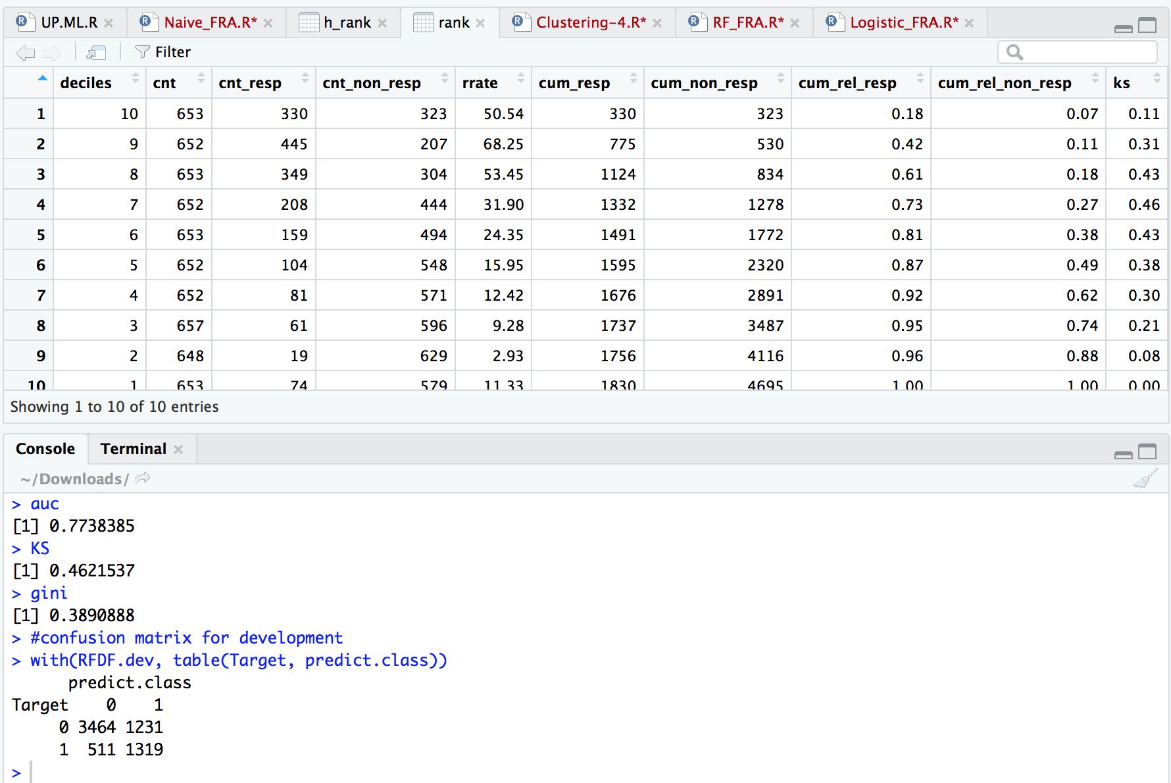
Development Model performance

Slide 33
Analyzing NB train model performance
Looking at performance measure of train model :
Confusion Matrix: Correctness of prediction is 73.39% and default prediction rate is 72%.

Slide 34
Run NB model on test data

Slide 35
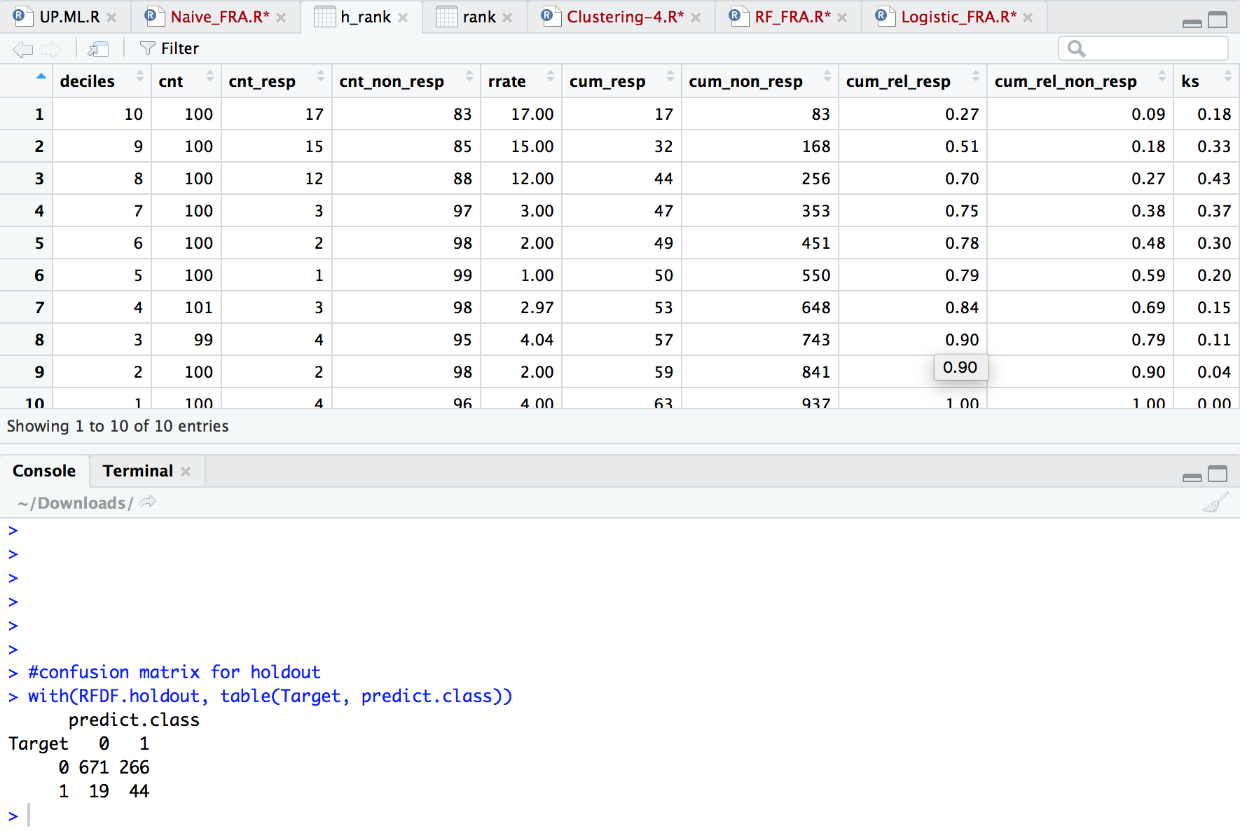
Holdout data Evaluation

Slide 36
Analyzing NB model on unseen test data
Looking at performance measure of model on unseen data:
Rank table: Top decile has 15% response rate i.e. 2.5 times 6% overall response before applying RF algorithm.
Confusion Matrix: Correctness of prediction is 72% and default prediction rate is 70%.

Slide 37
Thank You

